Slide 1
Memory Management
In Web Applications
(JavaScript)

Slide 2
Topics
Why memory management is important ?
Memory allocation lifecycle
Garbage Collection in JavaScript
Exploring DevTools
Analyzing memory allocations using snapshots

Slide 3


Why memory management is important ?
/home.aspx
/about.aspx
Traditional Web Apps
SPA & PWA
/index.html
More work at client side !!

Slide 4

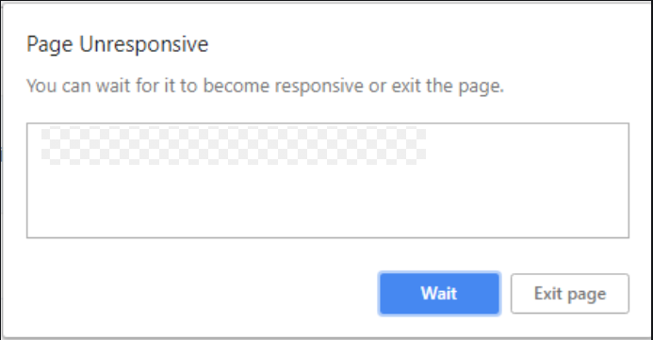
Memory Leaks

Slide 5



Memory allocation lifecycle
Allocate the memory
Use the allocated memory
Release the allocated memory, when it’s no longer needed

Slide 6
Garbage Collection in JavaScript
“mark-and-sweep” algorithm
Reference : Garbage collection (javascript.info)

